Slide 1
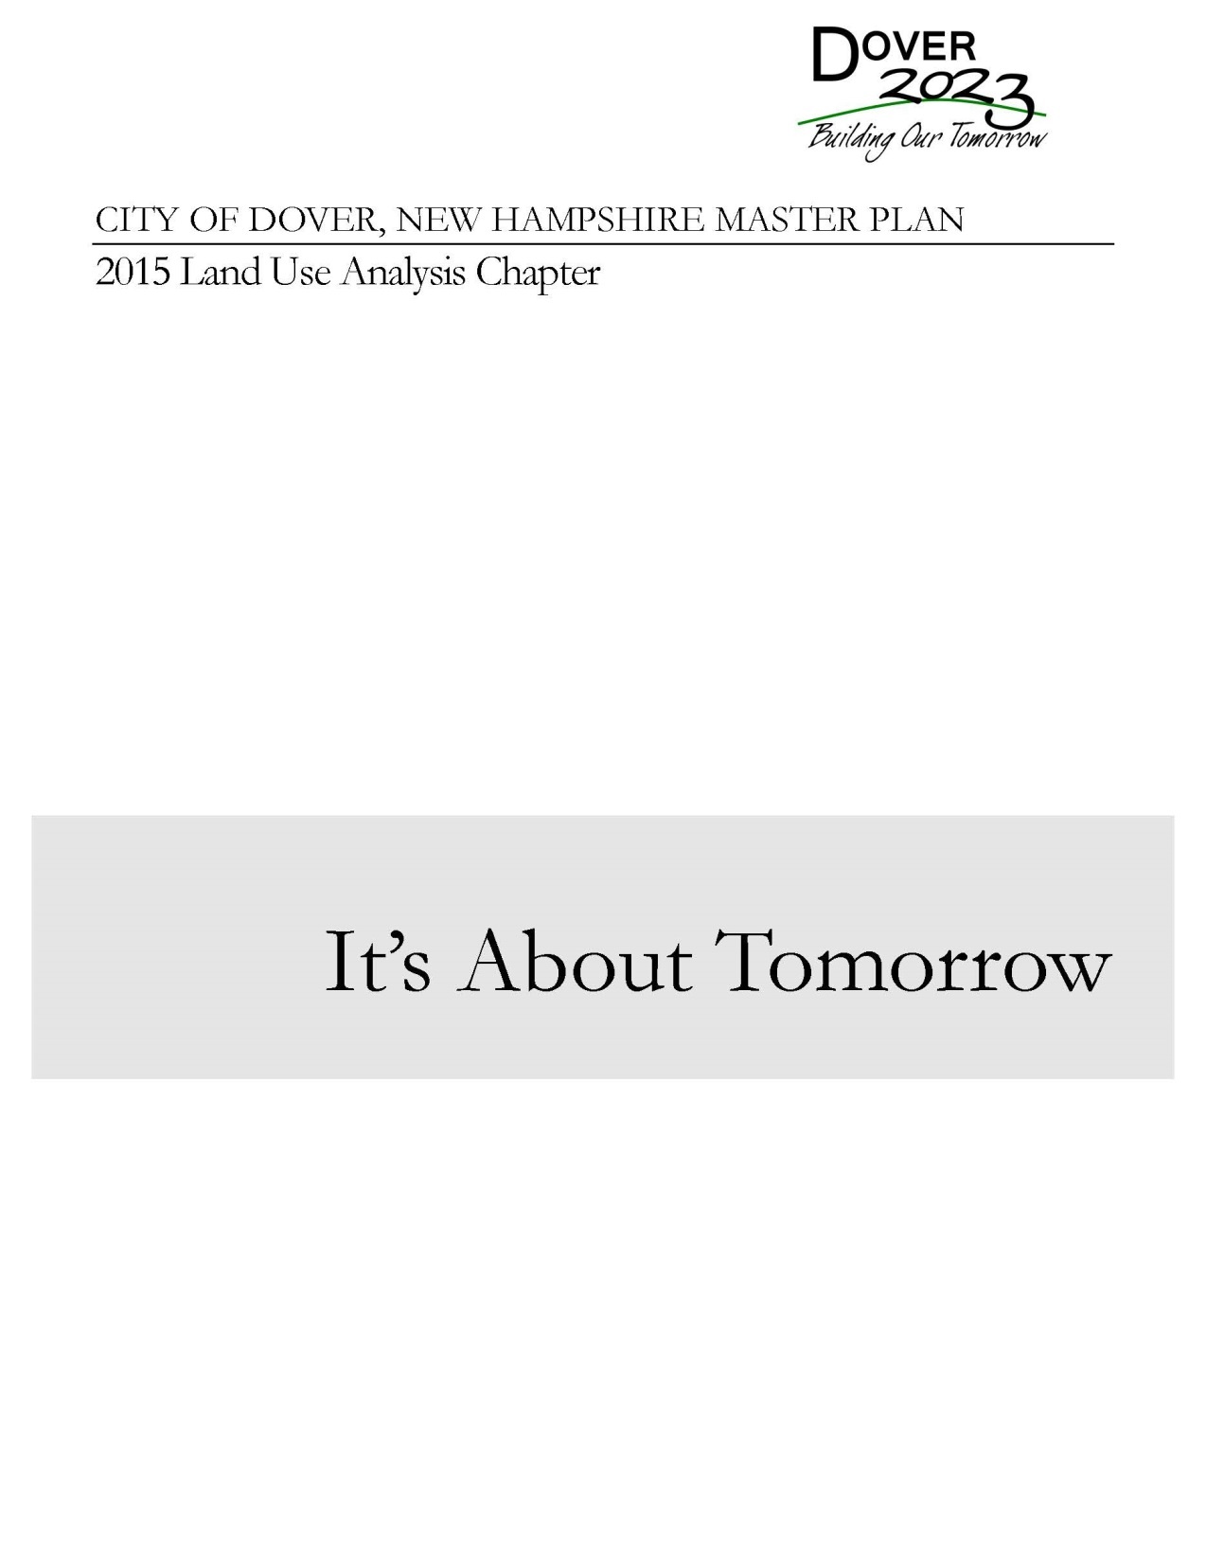
Notes:
Rationale…
Process Used…Starting in the Spring 0f 2014…Committee
Revisions review…new content…assisted by Craig Seymour of RKG and Dan Sundquist on GIS

Slide 2
Notes:
Outline of Chapter

Slide 3
Where are we now - 2015

Slide 4
Dover grew by 3,103 persons between 2000 and 2010 making it the fastest growing community in the region during that time, by absolute numbers.

Slide 5
Changes Since 2007 Land Use Chapter
Regulatory:
o Elimination of density bonus allowances for Open Space Subdivisions, as they became mandatory and no longer optional in many residential districts.
o Creation of the first Form Based Code in Northern New England for downtown.
o Creation of a Transit Oriented Development sub-district of the Central Business District
o Expanded residential Transfer of Development Rights opportunities to include a “land bank” as opposed to a market driven model.
o Expanded industrial Transfer of Development Rights opportunities to include commercial zones.
o Expanded area of the City where farming is an allowed use to pre-1979 levels.
o Made pervious surfaces mandatory in projects where there is over 1.5 acres of paving.
o Adopted a downtown Tax Increment Finance District.
o Strengthened site and building design by revising the Architectural Design Guidelines and making them Standards.
o Updated definitions for elderly care facilities.
o Encouraged Mixed Use as an incentive to Commercial Development
o Encouraged Mixed Use at appropriate locations along major corridors to encourage transit use and pedestrian activities.
o Restricted allowed residential uses in non-residential zones to be limited to the second floor or above.
o Adopted a special exception criteria to allow small non-residential uses to be located in existing residential neighborhoods.
o Changed setbacks so retail buildings front directly on a sidewalk with no setback, and revised zoning so all buildings are at least two stories tall and of a mixed use in the CBD and CWD zones.
o Revised allowances to construct on steep slopes and updated the Conservation District zoning regulations to be consistent with the Comprehensive Shoreland Protection Act.

Slide 6
Changes Since 2007 Land Use Chapter
Development:
o Liberty Mutual expanded its campus adding a second 200,000 square foot building.
The Children’s Museum of New Hampshire moved to downtown Dover.
o Wentworth Douglas Hospital expanded its campus with a 150,000 square foot building, as well as 100,000 square foot outpatient building on Indian Brook Drive.
o Conceptual approval of 100 acre mixed use development between Dover Point Road and Middle Road.
o FW Webb expanded its presence from 34,000 to 100,000 square feet.
o Conversion of 120,000 square feet of office space to 120 residential units in Cochecho Millworks downtown.
o Conversion of 50,000 square feet of warehouse to 42 residential units in Woodbury Mill downtown.
o Redevelopment of 100,000 square foot former school into the McConnell Center Social Service Hub downtown.
o Redevelopment of 120,000 square foot Moore Business Forms building into an manufacturing incubator space.
o Redevelopment of 270,000 square foot Goss Manufacturing building into an office and manufacturing space.
o Redevelopment of First Street parking lot to mixed use building with 7,000 square feet of commercial and 32 units of residential.

Slide 7
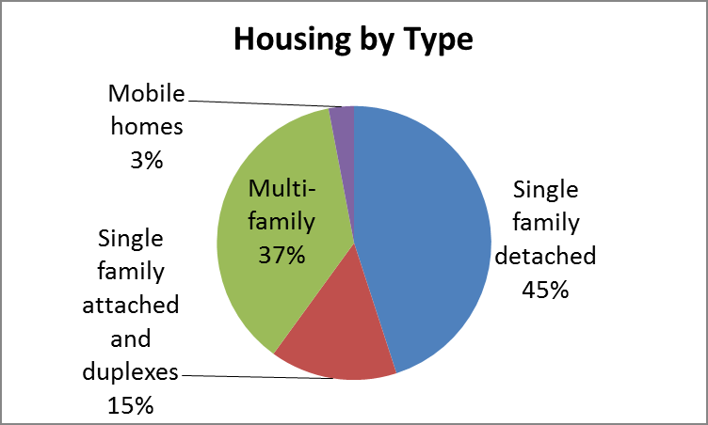
Dover has a smaller percentage of single family units and mobile homes than the County, and a higher percentage of multi-family units.
This variety gives the city a greater diversity of housing.

Slide 8
Dover first adopted a Master Plan in 1963, and since that time has evolved from a community centered on manufacturing to a city boasting a reemerging downtown and varied housing opportunities. The residents of Dover have created a vision for a dynamic community with an outstanding quality of life that is dependent on the actions taken in regards to land use.

Slide 9
Where are we going – Future Land Use

Slide 10
Downtown:
· The majority of future development should be located in or near downtown.
· Continue to encourage in-fill and mixed -use development with in a ½ mile or so of the downtown core.
Waterfront Area:
· Potential for a major mixed -use development on the city’s former public works site on the river.
· This development effort has the potential to compliment other redevelopment efforts in the downtown while providing greater public access to the river.
Advanced Manufacturing Cluster:
· Encourage higher densities in the existing industrial and business parks.
· Promote a wider range of uses that mix office, retail, distribution and fabrication activities
Low Density Residential:
· Continue to promote lower density residential zoning (e .g. conservation subdivisions) and promote agricultural uses along with land conservation measures.
· Continue to identify and purchase conservation easements on properties with critical natural resources.

Slide 11
Medium Density Residential:
· Encourage residential development at a moderate density on smaller lots served by municipal water and sewer. Many of these areas already have established neighborhoods.
· Continue to identify and purchase conservation easements on properties with critical natural resources.
· Review Open Space Subdivision requirements to promote usage of that development technique.
High Density Residential:
· Continue to promote higher density suburban development for a mix of residential types. Some commercial and office uses may be allowed in the areas closer to downtown.
· Review Open Space Subdivision requirements to ensure context sensitivity.
Mixed Use:
· Encourage a mix of residential and commercial uses that are compatible with each other in areas outside of the downtown area.
Retail Corridor:
· Continue to promote retail and commercial development along highway corridors and encourage redevelopment with more attractive buildings and parking areas that contain green drainage infrastructure and attractive landscaping.

Slide 13
Implementing the Vision
This Future Land Use section of the Master Plan provides a direction for guiding land use change and community development efforts.
The following implementation program is intended to bring about the Vision for Dover.

Slide 14
Dover will be a dynamic and sustainable community—a desirable place to live and work with family friendly neighborhoods, a vibrant historic downtown, a variety of housing opportunities, excellent schools and municipal services, an economic base with stable, well-paying employers and a place served by a variety of transportation types and systems. We will also preserve its rural character through preservation of its natural resources as well as its cultural and architectural heritage for current and future generations. We envision a diverse community that promotes social, cultural, and recreational opportunities for all age groups.

